Slide 1
AXI-SPI Core
Waseem Orphali
Colin Fritz

Slide 2

Outline
1
Project Overview
9
SPI Simulation Snapshot
2
I/O Interface Diagram
10
Top Entity
3
Requirements​
11
Lifecycle Data
4
SPI Sub Modules
12
Synthesis
5
AXI Sub Modules
6
AXI Test Procedures
7
AXI Simulation Snapshot
8
SPI Test Procedures

Slide 3
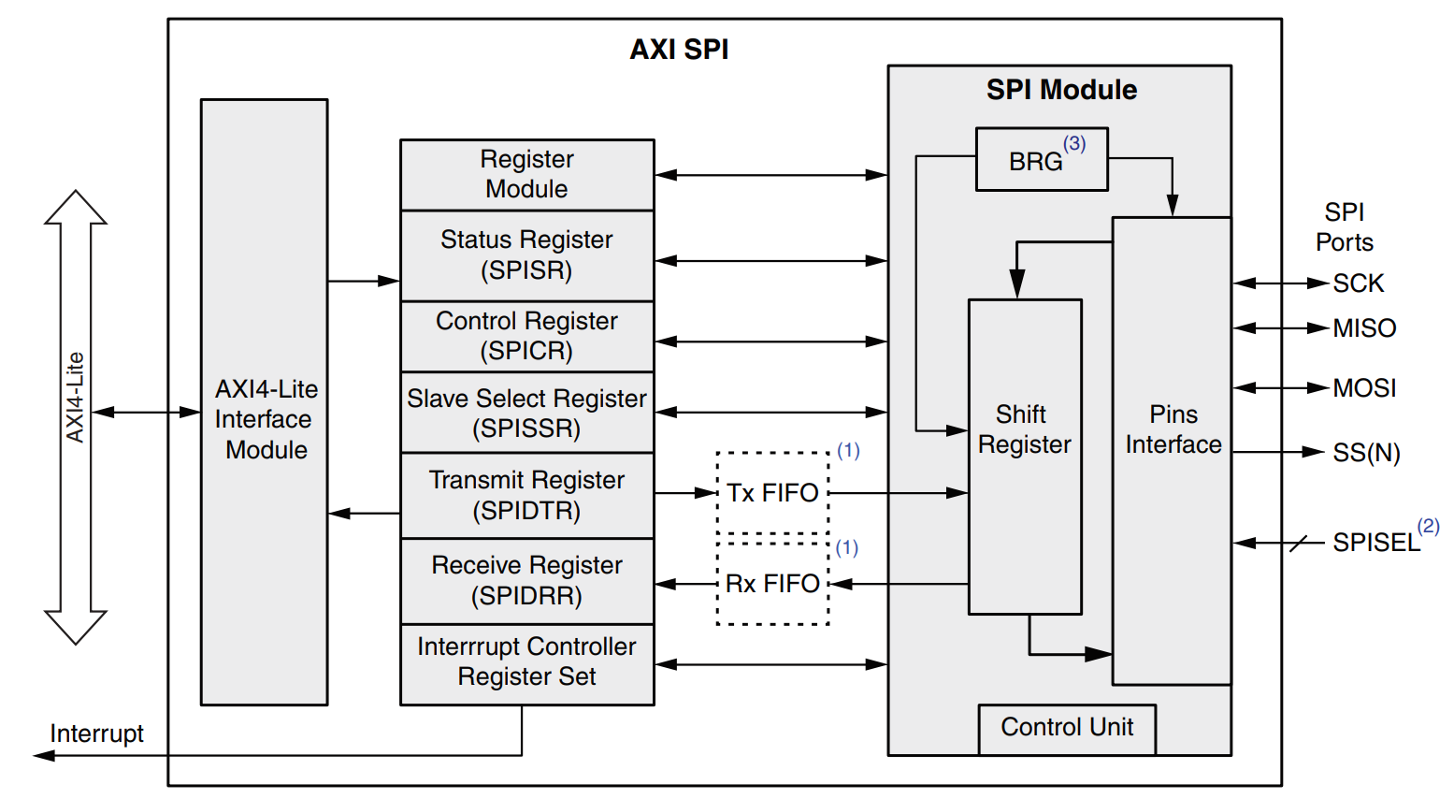
Project Overview
Facilitate communication between AXI4-Lite and SPI protocols.
The core consists of the following:
Parallel AXI4-Lite interface
SPI interface
Internal control registers
Internal First-In-First-Out memory
Interrupt controller
Operates only as AXI4 slave.
Can operate as SPI master or slave.

Slide 4
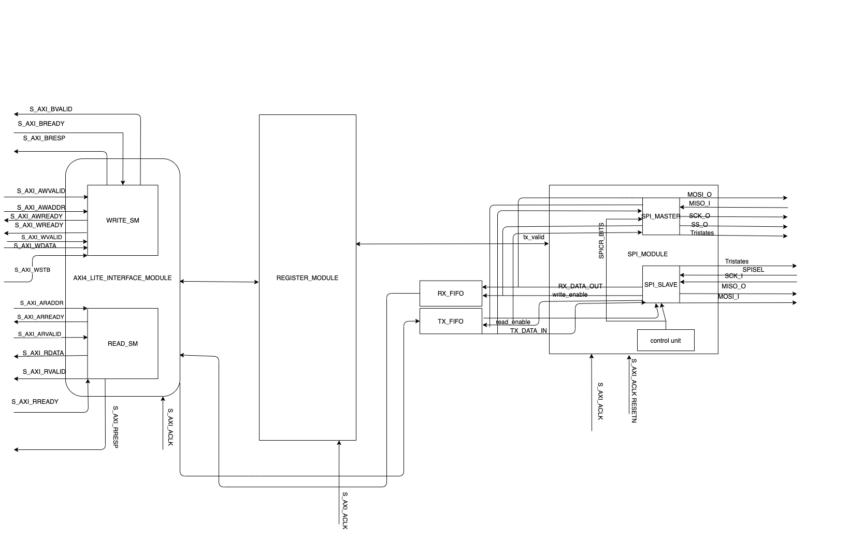
I/O Interface Diagram
Modular design with defined I/O interfaces. All synchronized to S_AXI_ACLK.
Three channels for AXI communication:
Read channel
Write channel
Response channel
The TX_FIFO and RX_FIFO connect directly to the AXI interface module and the SPI interface module

Slide 5
Requirements
AXI4 LITE Interface transaction.
SPI protocol with CPOL and CPHA 0.
AXI4 interface shall communicate with the Register module via read/write pulses.
Register Module shall return information about the success or failure of individual read and write requests to the AXI Interface.
Read and Write AXI4 Lite transaction shall not occur to the same address within 6 clock cycles of each other.
Register Module components shall be 32 bit.
Register Module shall be read only or update on write according to the data sheet.
SPI Master and Slave shall expect at least 6 clock cycles between transactions.

Slide 6
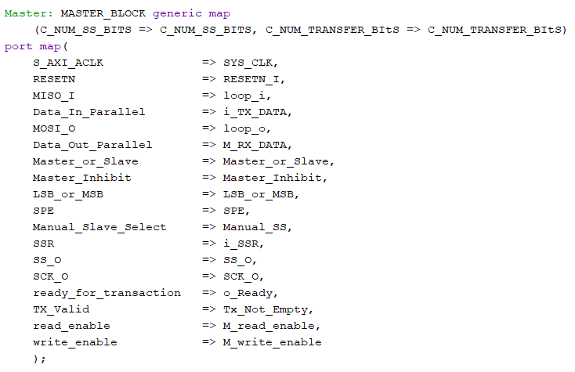
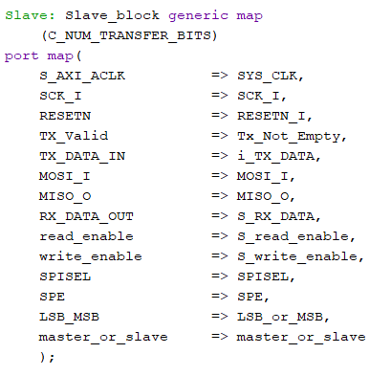
SPI Sub Modules
Communicates with FIFO and Register Module via read and write request pulses. Communicates with external slaves via SPI protocol. Handles all Master SPI transaction logic internally.
Communicates with FIFO and Register Module the same as SPI Master block. If a transaction is initiated with no new data in the TX buffer all zeros are sent. Handles all SPI slave logic internally.

Slide 7
AXI Sub Modules
READ_SM pseudo code
When => Wait_for_address_valid
- if master asserts address valid transition to wait_for_ack
- if master asserts address valid set read_enable and latch address
When => wait_for_ack
-if register returns ack signal for current transaction transition to wait_master_read_ready
-deassert read_enable and read_address
When => wait_master_read_ready
-if master asserts ready deassert rvalid from core
- new transaction may begin when wait_for_address_valid is reentered

Slide 8
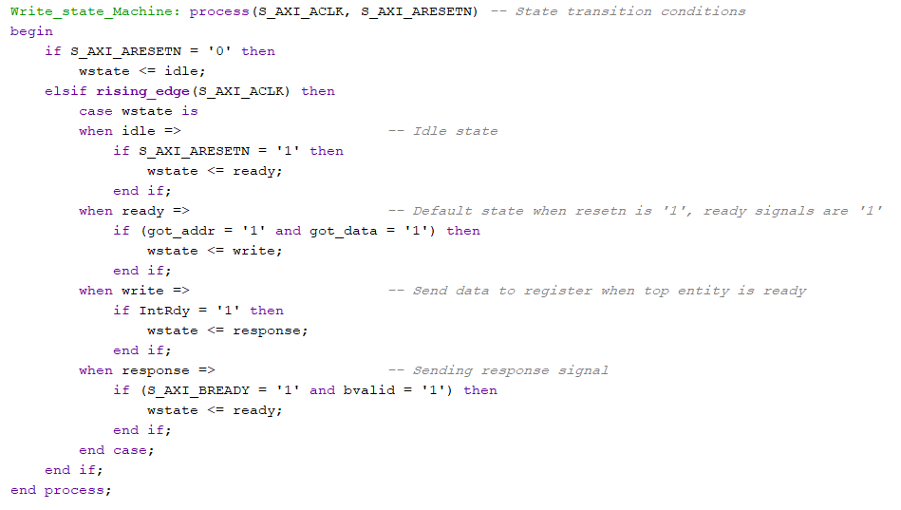
AXI Sub Modules
State transition process, second process sets signal values for each state

Slide 9
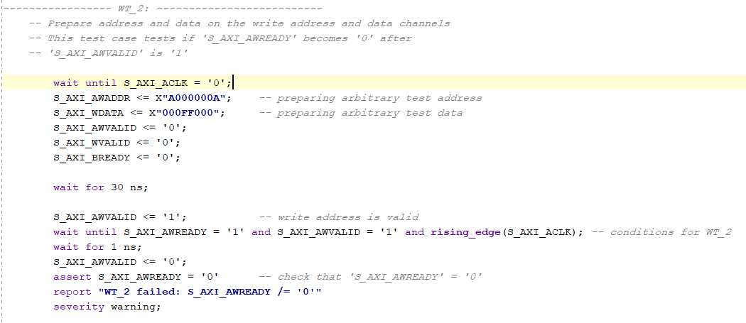
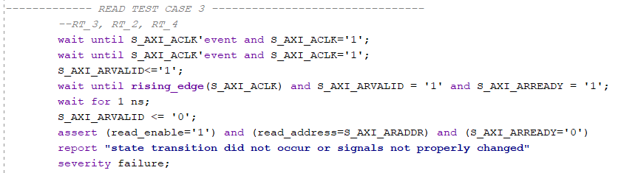
AXI Test Procedures​

Slide 10
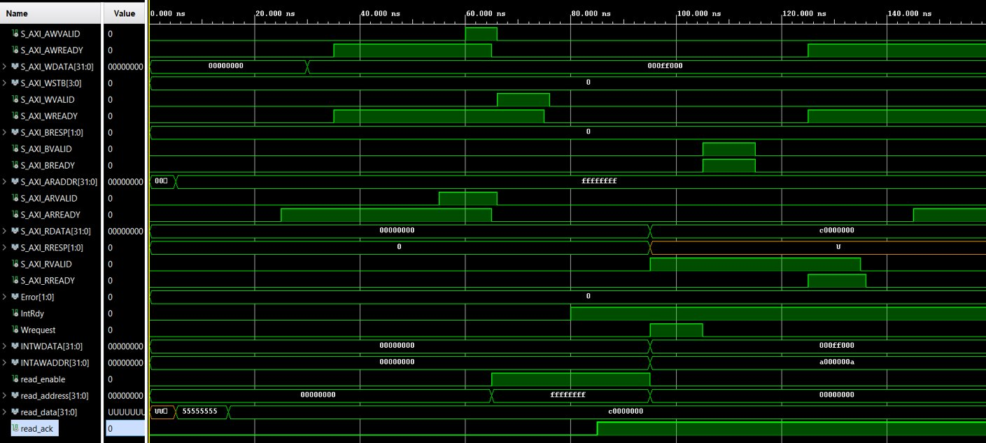
AXI Simulation Snapshot​

Slide 11
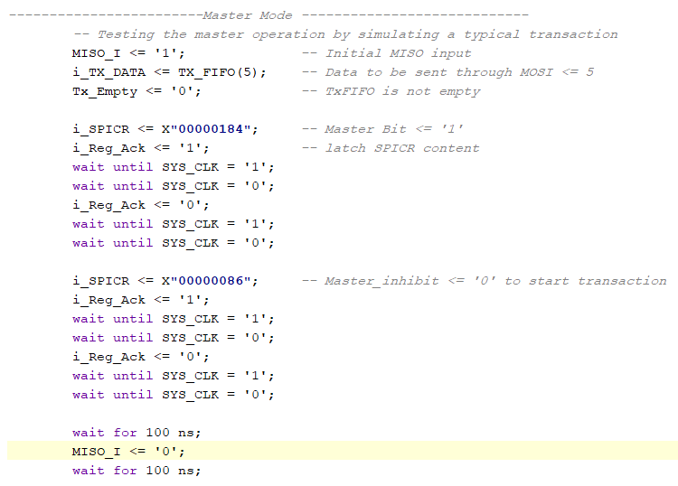
SPI Test Procedures​

Slide 12
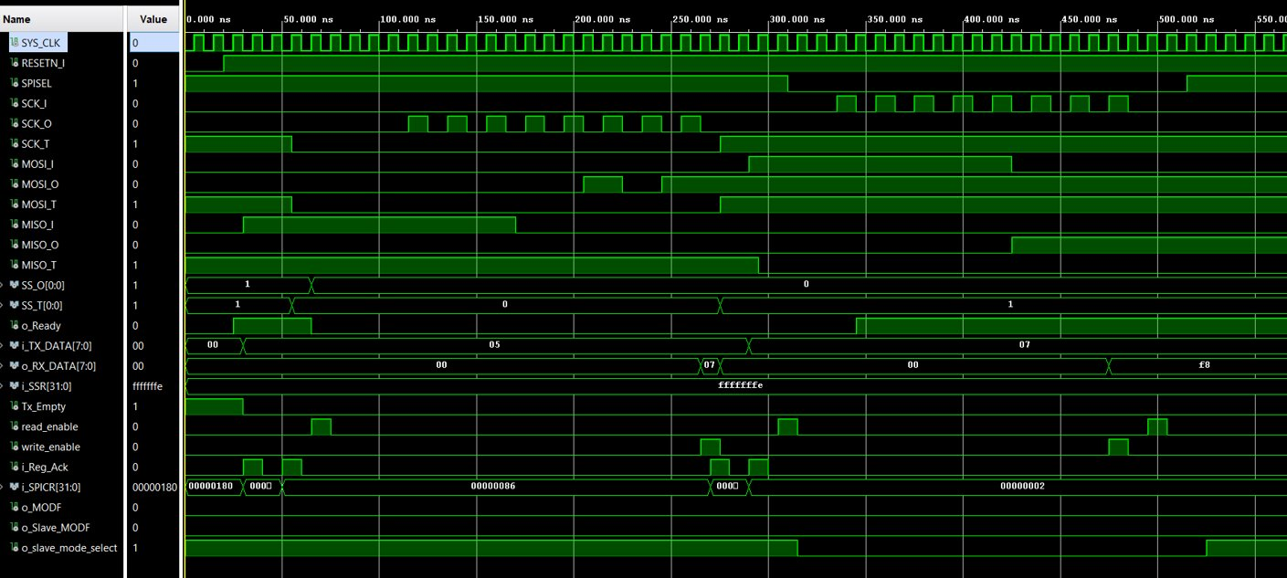
SPI Simulation Snapshot​

Slide 13
Top Entity
Acts as the main controller for the core.
Instantiates the following components:
AXI Module
SPI Module
Register Module
Tx FIFO
Rx FIFO
Interrupt Controller
Coordinates signaling to achieve successful data transfer between AXI and SPI.

Slide 14
Lifecycle Data
Plan, requirements, code, tests/test traceability
Github Repository:
https://github.com/waseem55/AXI_SPI

Slide 15
Synthesis

Slide 16
Thank You
Waseem Orphali
Colin Fritz

